Slide 1
TOWN OF TRUCKEE
GLENSHIRE PROJECTS
SUMMER 2016 AND 2017
Scott Mathot
Assistant Engineer
April 13, 2016

Slide 2
Town Projects in Glenshire
Implement/Construct multiple projects in Glenshire over the next two summers
Town annually completes slurry seal application to Glenshire streets on a tri-annual basis
Important projects coming to Glenshire in the next two years!

Slide 3
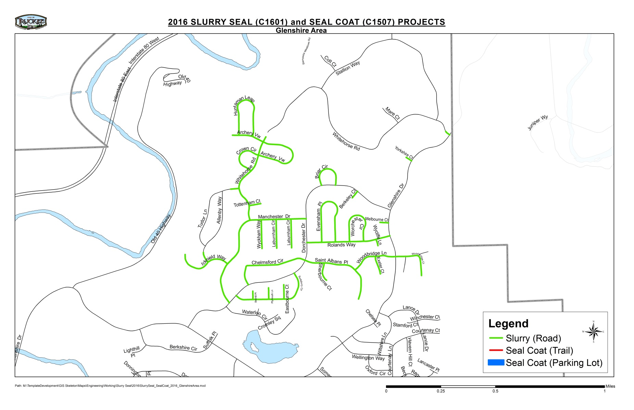
2016 Slurry Seal Program

Slide 4
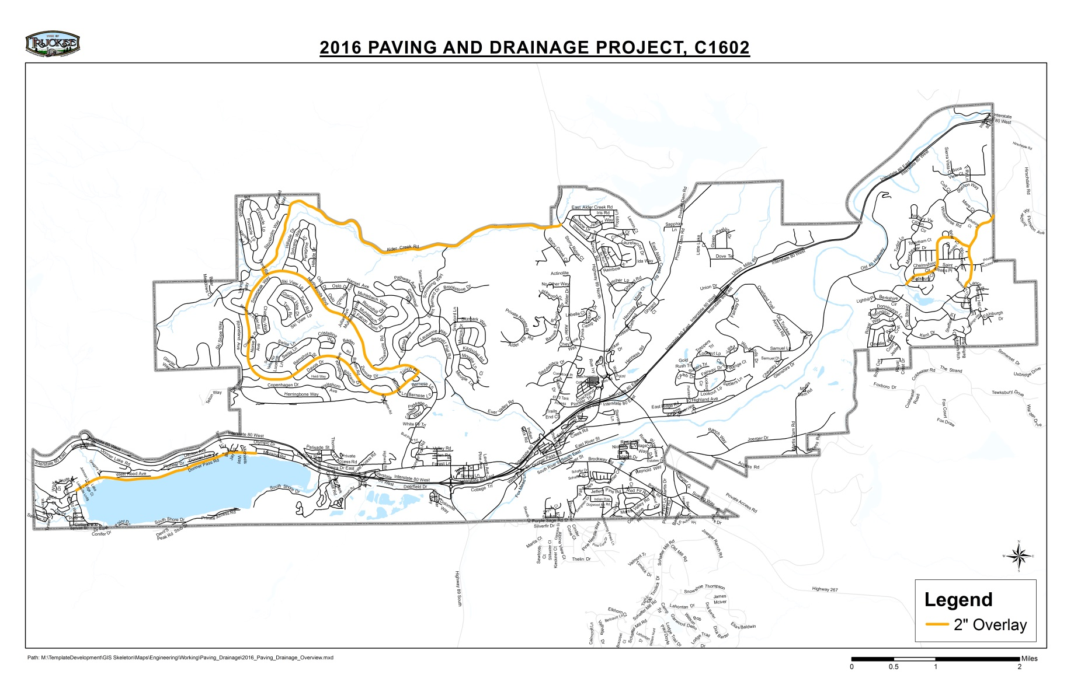
2016 Paving and Drainage

Slide 5
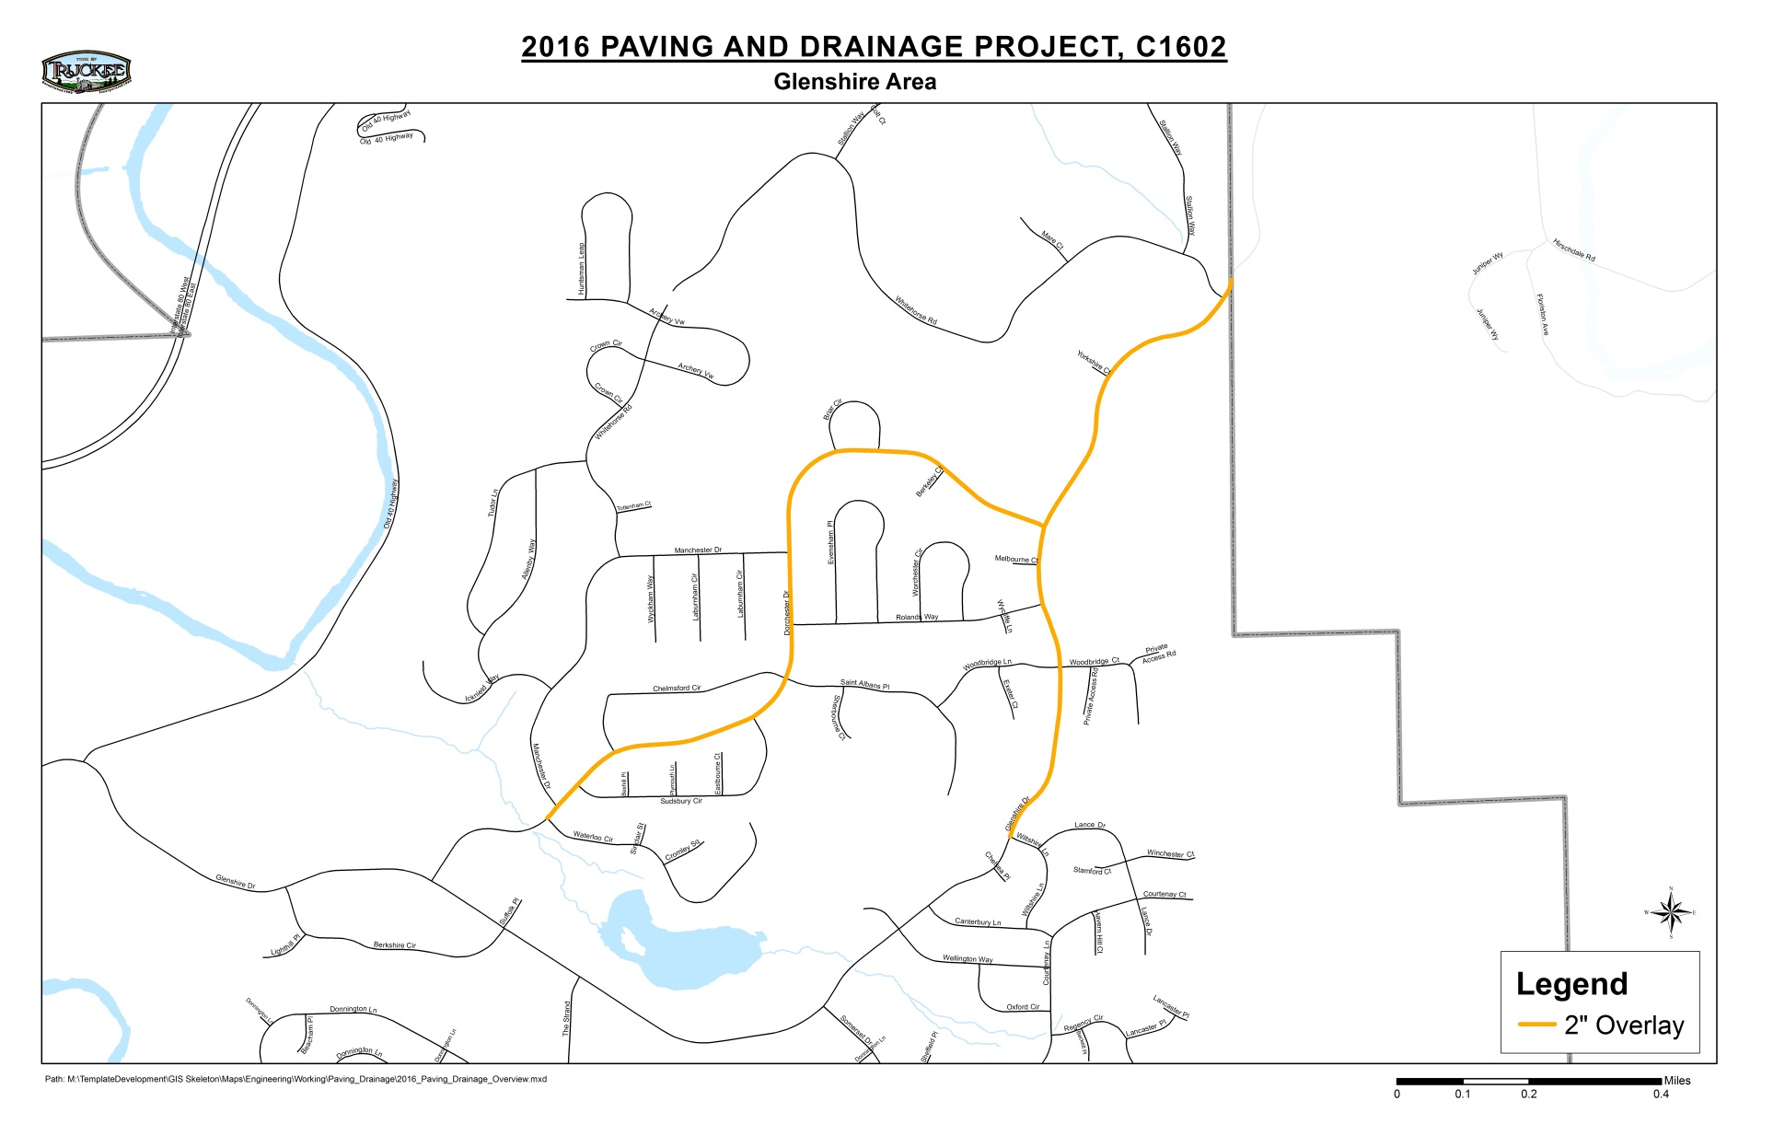
Glenshire Drive from Wiltshire Lane to Town Limit
Dorchester Drive from Waterloo Circle to Glenshire Drive

Slide 6
Truckee River Legacy Trail Glenshire Trailhead (2016)
Construct 33 space trailhead parking facility
Provide amenities such as:
Trail Access
Picnic Tables
Trash/Recycling Enclosure
Pet Waste Bag Dispenser
Interpretive Exhibit

Slide 7
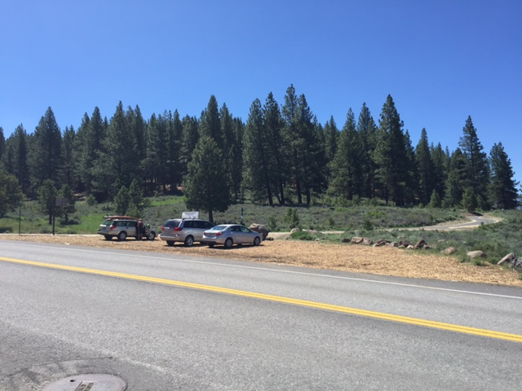

Slide 8
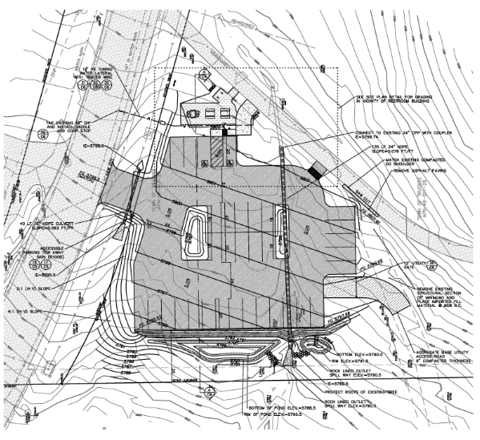

Slide 9
2017 Glenshire Drive/Dorchester Drive Widening Project
Widen Glenshire Drive from Berkshire Circle to Wiltshire Lane
Widen Dorchester Drive from Glenshire Drive to Waterloo Circle
Both roads will be widened, reconstructed, and repaved to provide Class 2 bike lanes through Glenshire

Slide 10
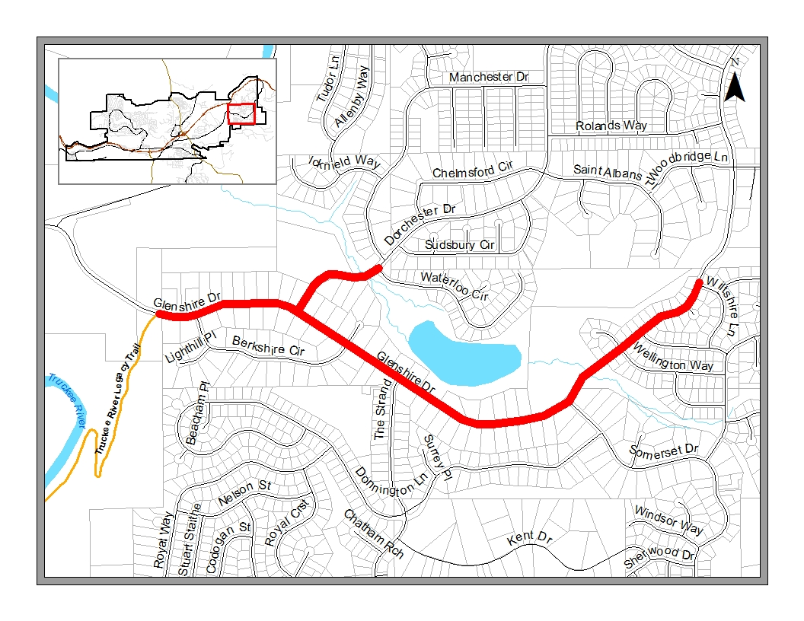
2017 Glenshire Drive/Dorchester Drive Widening Project

Slide 11
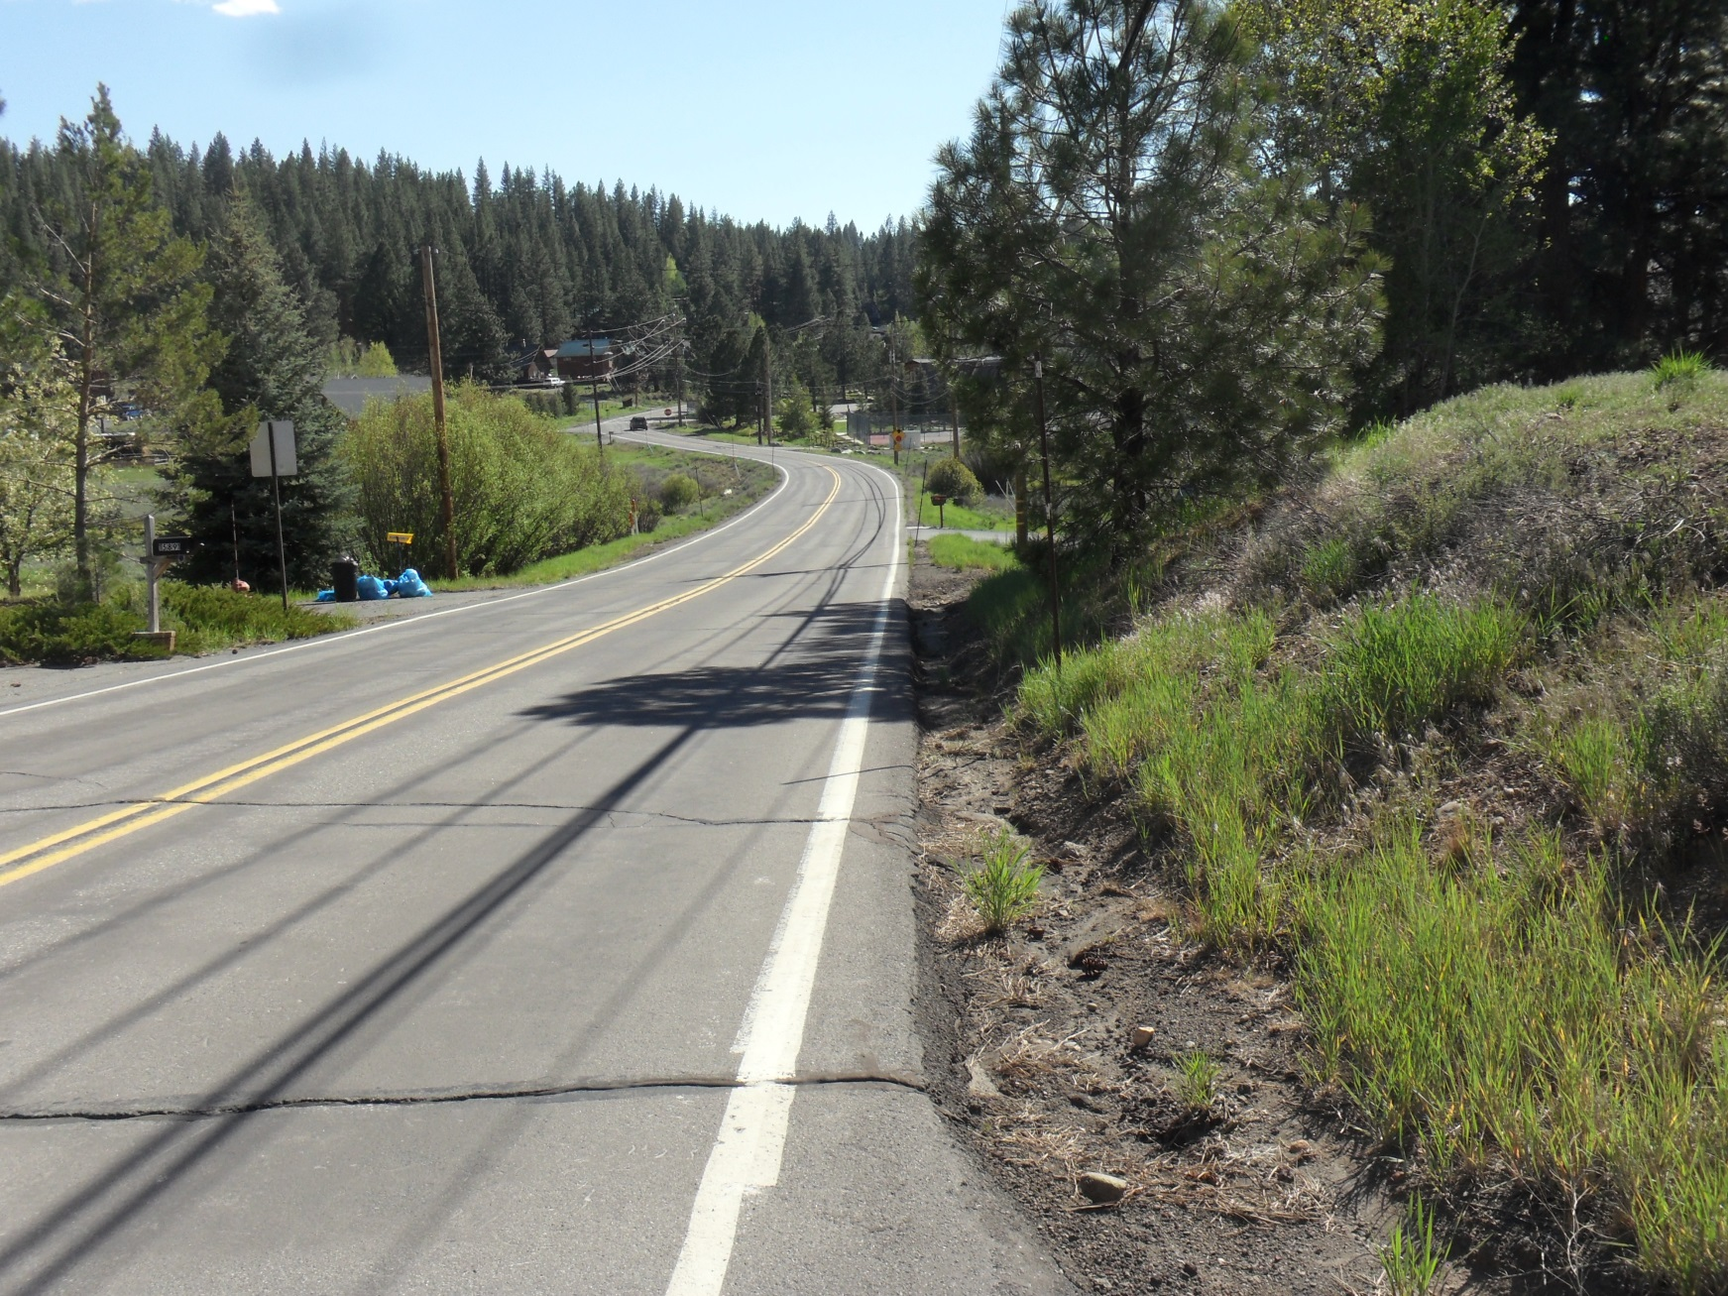

Slide 12
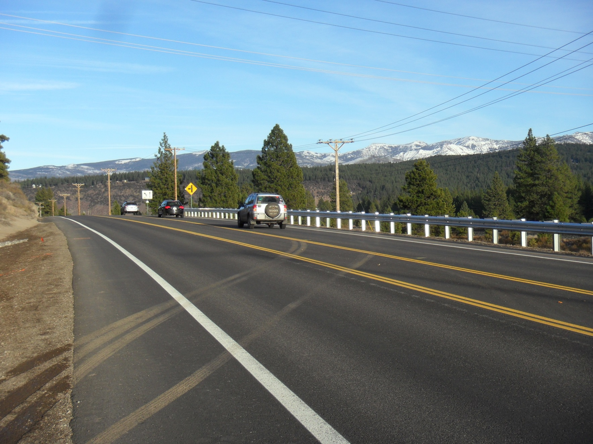

Slide 13
Questions about Town projects?
Feel free to contact:
Scott Mathot, Assistant Engineer
smathot@townoftruckee.com
O: 530-582-2481
C: 530-414-4873

